Slide 1
Recognizing specific objects Matching with SIFT
Original suggestion Lowe, 1999,2004

Slide 2
Applications of SIFT
Object recognition
Object categorization
Location recognition
Robot localization
Image retrieval
Image panoramas
Notes:
2

Slide 3
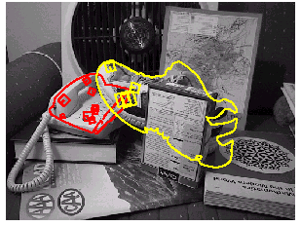
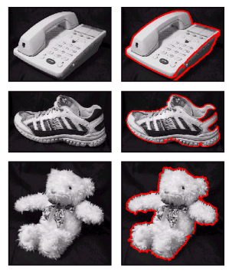
Object Recognition
Object Models

Slide 4
Object Categorization
Notes:
4

Slide 5
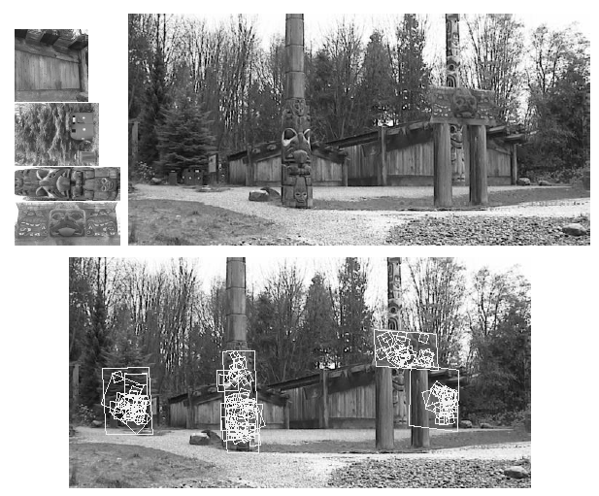
Location recognition
Notes:
5

Slide 6
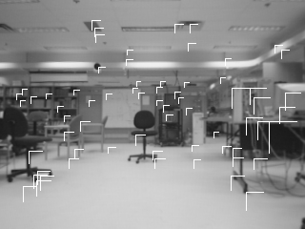
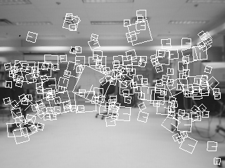
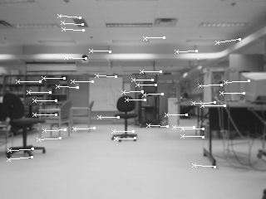
Robot Localization
Notes:
6

Slide 7
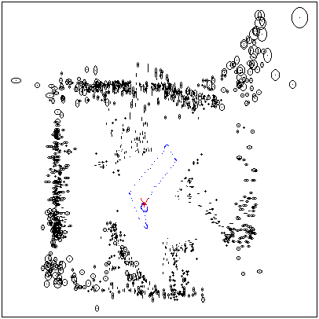
Map continuously built over time
Notes:
7

Slide 8
SIFT Computation – Steps
(1) Scale-space extrema detection
Extract scale and rotation invariant interest points (i.e., keypoints).
(2) Keypoint localization
Determine location and scale for each interest point.
Eliminate “weak” keypoints
(3) Orientation assignment
Assign one or more orientations to each keypoint.
(4) Keypoint descriptor
Use local image gradients at the selected scale.
D. Lowe, “Distinctive Image Features from Scale-Invariant Keypoints”, International Journal
of Computer Vision, 60(2):91-110, 2004.

Slide 9
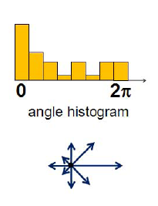
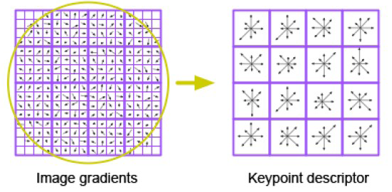
4. Keypoint Descriptor (cont’d)
Take a 16 x16 window around detected interest point.
Divide into a 4x4 grid of cells.
Compute histogram in each cell.
(8 bins)
16 histograms x 8 orientations
= 128 features

Slide 10
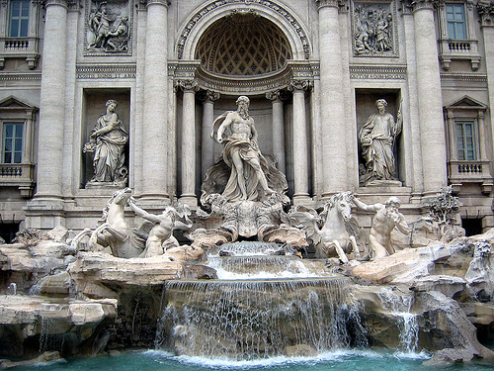
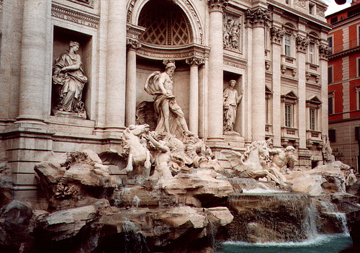
Matching SIFT features
Given a feature in I₁, how to find the best match in I₂?
Define distance function that compares two descriptors.
Test all the features in I₂, find the one with min distance.
I₁
I₂
Notes:
10

Slide 11

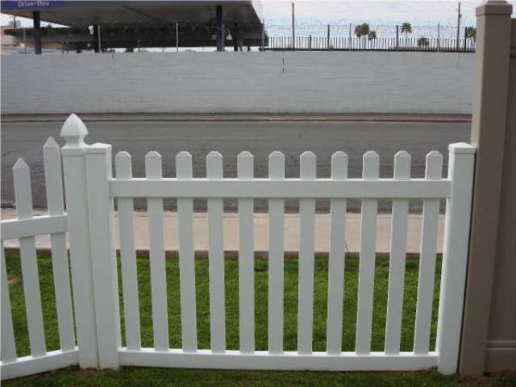
Matching SIFT features (cont’d)
f₁
f₂
I₁
I₂
Notes:
11

Slide 12
Matching SIFT features (cont’d)
Accept a match if SSD(f1,f2) < t
How do we choose t?

Slide 13
Matching SIFT features (cont’d)
A better distance measure is the following:
SSD(f₁, f₂) / SSD(f₁, f₂’)
f₂ is best SSD match to f₁ in I₂
f₂’ is 2nd best SSD match to f₁ in I₂
f₁
f₂'
f₂
I₁
I₂
Notes:
13

Slide 14
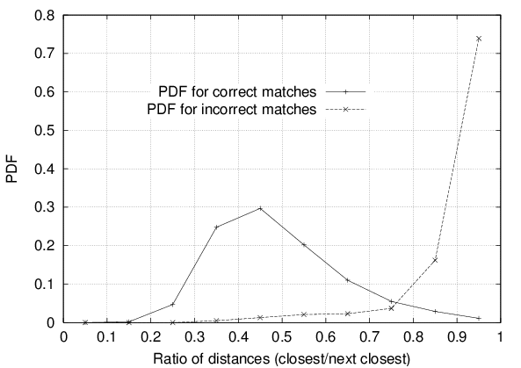
Matching SIFT features (cont’d)
Accept a match if SSD(f₁, f₂) / SSD(f₁, f₂’) < t
t=0.8 has given good results in object recognition.
90% of false matches were eliminated.
Less than 5% of correct matches were discarded
Notes:
14

Slide 15
Variations of SIFT features
PCA-SIFT
SURF
GLOH

Slide 16
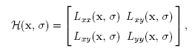
SURF: Speeded Up Robust Features
Speed-up computations by fast approximation of (i) Hessian matrix and (ii) descriptor using “integral images”.
What is an “integral image”?
Herbert Bay, Tinne Tuytelaars, and Luc Van Gool, “SURF: Speeded Up Robust Features”, European Computer Vision Conference (ECCV), 2006.
Notes:
16
16

Slide 17
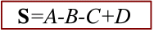
Integral Image
The integral image I_{Σ}(x,y) of an image I(x, y) represents the sum of all pixels in I(x,y) of a rectangular region formed by (0,0) and (x,y).
.
Using integral images, it takes only four array references to calculate the sum of pixels over a rectangular region of any size.
Notes:
17
17

Slide 18
SURF: Speeded Up Robust Features (cont’d)
Approximate L_{xx}, L_{yy}, and L_{xy} using box filters.
Can be computed very fast using integral images!
(box filters shown are 9 x 9 – good approximations for a Gaussian with σ=1.2)
derivative
approximation
derivative
approximation
Notes:
18
18

Slide 19
SURF: Speeded Up Robust Features (cont’d)
In SIFT, images are repeatedly smoothed with a Gaussian and subsequently sub-sampled in order to achieve a higher level of the pyramid.
Notes:
19
19

Slide 20
SURF: Speeded Up Robust Features (cont’d)
Alternatively, we can use filters of larger size on the original image.
Due to using integral images, filters of any size can be applied at exactly the same speed!
(see Tuytelaars’ paper for details)
Notes:
20
20

Slide 21
SURF: Speeded Up Robust Features (cont’d)
Approximation of H:
Using DoG
Using box filters
Notes:
21
21

Slide 22
SURF: Speeded Up Robust Features (cont’d)
Instead of using a different measure for selecting the location and scale of interest points (e.g., Hessian and DOG in SIFT), SURF uses the determinant of to find both.
Determinant elements must be weighted to obtain a good approximation:
Notes:
22
22

Slide 23
SURF: Speeded Up Robust Features (cont’d)
Once interest points have been localized both in space and scale, the next steps are:
(1) Orientation assignment
(2) Keypoint descriptor
Notes:
23
23

Slide 24
SURF: Speeded Up Robust Features (cont’d)
Orientation assignment
Circular neighborhood of
radius 6σ around the interest point
(σ = the scale at which the point was detected)
60⁰
^{angle}
x response y response
Haar wavelets (responses weighted with Gaussian)
Side length = 4σ
Can be computed very fast using integral images!
Notes:
24
24

Slide 25
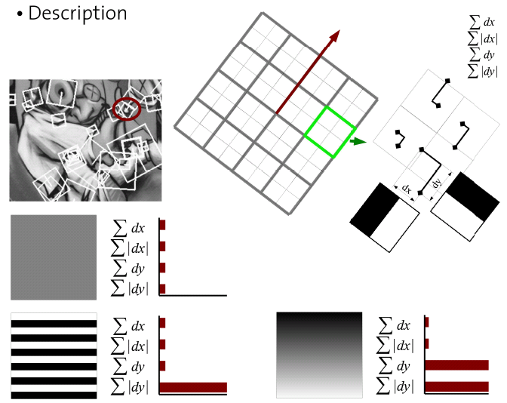
SURF: Speeded Up Robust Features (cont’d)
Keypoint descriptor (square region of size 20σ)
4 x 4
grid
Sum the response over each sub-region for d_{x} and d_{y} separately.
To bring in information about the polarity of the intensity changes, extract the sum of absolute value of the responses too.
Feature vector size:
4 x 16 = 64
Notes:
25
25

Slide 26
SURF: Speeded Up Robust Features (cont’d)
SURF-128
The sum of d_{x} and |d_{x}| are computed separately for points where d_{y} < 0 and d_{y} >0
Similarly for the sum of d_{y} and |d_{y}|
More discriminatory!
Notes:
26
26

Slide 27
SURF: Speeded Up Robust Features
Has been reported to be 3 times faster than SIFT.
Less robust to illumination and viewpoint changes compared to SIFT.
K. Mikolajczyk and C. Schmid,"A Performance Evaluation of Local Descriptors",
IEEE Transactions on Pattern Analysis and Machine Intelligence, vol. 27, no. 10,
pp. 1615-1630, 2005.
Notes:
27
27

Slide 28
About matching…
Can be done with as few as 3 features.
Use Hough transform to cluster features in pose
space
Have to use broad bins since 4 items but 6 dof
Match to 2 closest bins
After Hough finds clusters with 3 entries
Verify with affine constraint

Slide 29
Hough Transform Clustering
Create 4D Hough Transform (HT) Space for each reference image
Orientation bin = 30° bin
Scale bin = 2
X location bin = 0.25*ref image width
Y location bin = 0.25*ref image height
If key point “votes” for reference image, tally its vote in 4D HT Space.
This gives estimate of location and pose
Keep list of which key points vote for a bin

Slide 30
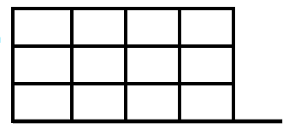
Hough Transform Example (Simplified)
For the Current View, color feature match with the
database image
If we take each feature and align the database image at that feature we can vote for the x position of the center of the object and the theta of the object based on all the poses that align
X position
0
90
Theta
180
270

Slide 31
Hough Transform Example (Simplified)
Database Image
Current Item
Assume we have 4 x locations
And only 4 possible rotations (thetas)
X position
Then the Hough space can look like the Diagram to the left
0
90
Theta
180
270

Slide 32
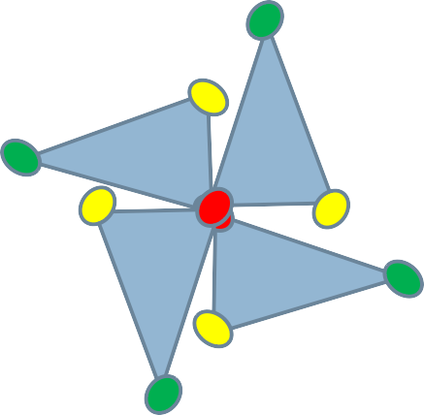
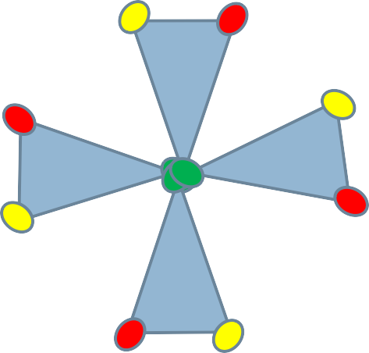
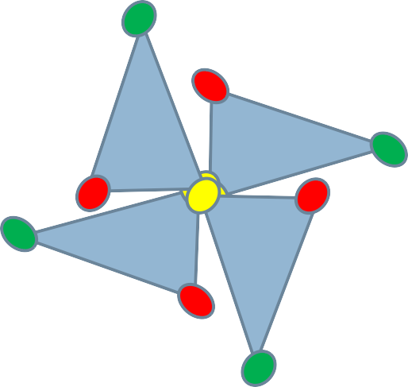
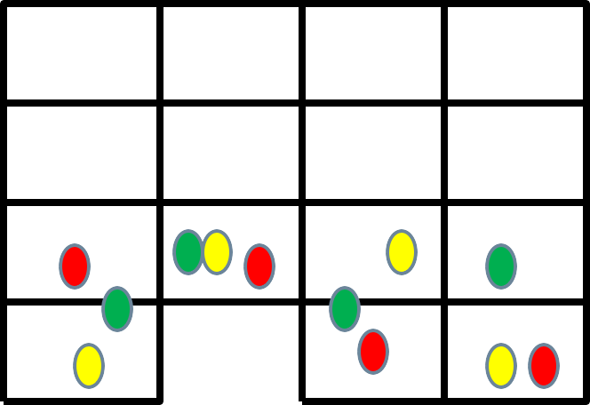
Hough Transform Example (Simplified)
X position
0
90
Theta
180
270

Slide 33
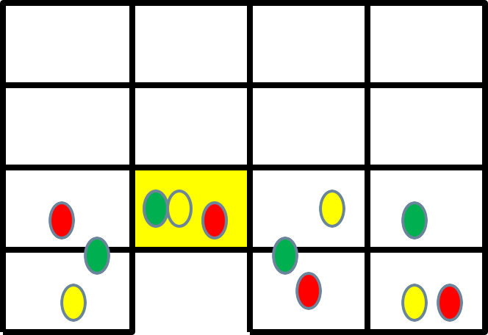
Hough Transform Example (Simplified)
X position
0
90
Theta
180
270

Slide 34
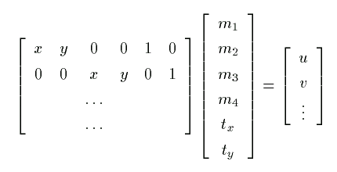
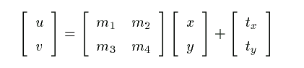
3. Feature matching
3D object recognition: solve for pose
Affine transform of [x,y] to [u,v]:
Rewrite to solve for transform parameters:

Slide 35
3. Feature matching
3D object recognition: verify model
Discard outliers for pose solution in prev step
Perform top-down check for additional features
Evaluate probability that match is correct

Slide 36
Two View Geometry (simple cases)
In two cases this results in homography:
Camera rotates around its focal point
The scene is planar
Then:
Point correspondence forms 1:1mapping
depth cannot be recovered

Slide 37
Camera Rotation
(R is 3x3 non-singular)

Slide 38
Planar Scenes
Scene
Intuitively
A sequence of two perspectivities
Algebraically
Need to show:
Camera 2
Camera 1

Slide 39
Summary: Two Views Related by Homography
Two images are related by homography:
One to one mapping from p to p’
H contains 8 degrees of freedom
Given correspondences, each point determines 2 equations
4 points are required to recover H
Depth cannot be recovered

Slide 40
OpenCV packages
FindHomography
FlannBasedMatcher FLANN stands for Fast Library for Approximate Nearest Neighbors. It contains a collection of algorithms optimized for fast nearest neighbor search in large datasets and for high dimensional features.
Uses k-d trees

